Slide 1

Moving away from Docker and leaving its risks behind
OCI based projects Podman, Buildah, Skopeo & CRI-O.
William G Henry
Senior Distinguished Engineer
Portfolio Architectures

Slide 2



Container tools landscape is changing.
Why?
INTRODUCTION
Since Open Container Initiative (OCI) there are several new projects
What needs do these projects address?
What are these projects and when should I use them?
What specific security concern does each address?
Notes:
This is a 300 level presentation. And it includes some relatively complex demos.

Slide 3
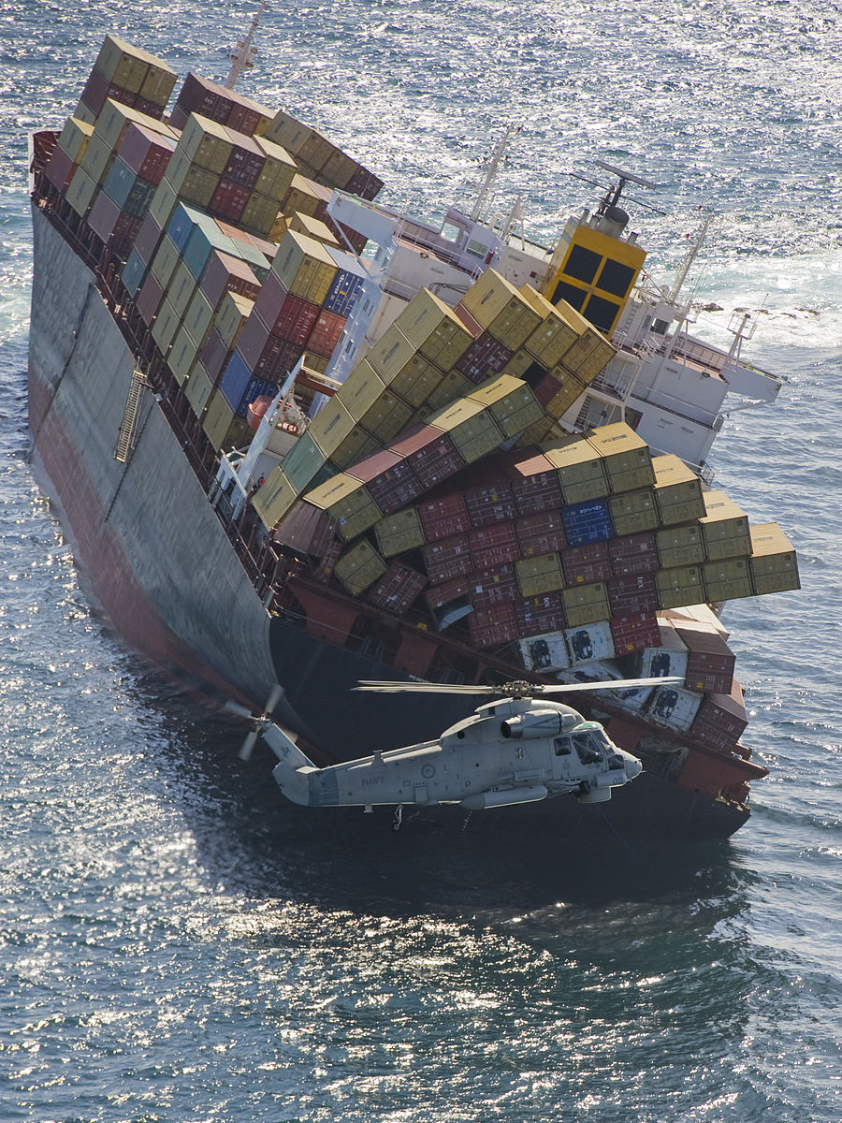
Early concerns with Docker
INTRODUCTION
Since the early days enterprise users of Docker had concerns
Build requires a “big fat” daemon on every host
Regression for integration with container platforms Kubernetes/OpenShift
Build has secret handling issues
Root/privileged concerns at runtime
Root/privileged concerns with daemon
Build requires a running container

Slide 4

INTRODUCTION
Docker, Red Hat et al. June 2015
Two specifications
Image format
How to package an OCI Image with sufficient information to launch the application on the target platform
Runtime
How to launch a “filesystem bundle” that is unpacked on disk
Version 1.0 of each released July 19th 2017
Distribution spec started in April, 2018.

Slide 5
Containers are Linux
CONTAINERS ARE LINUX

Slide 6
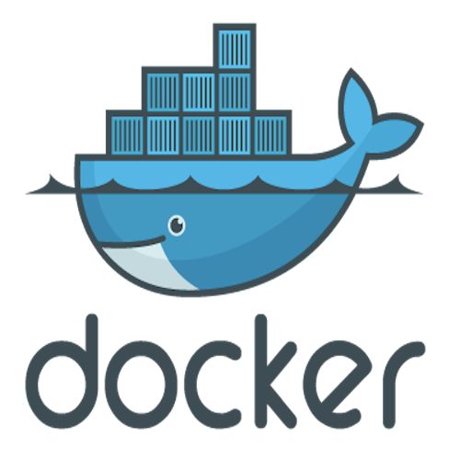



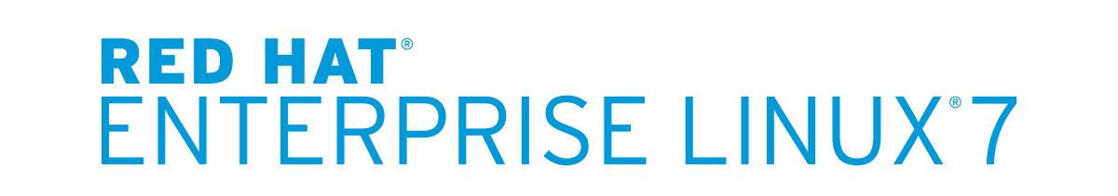

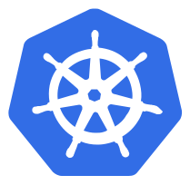



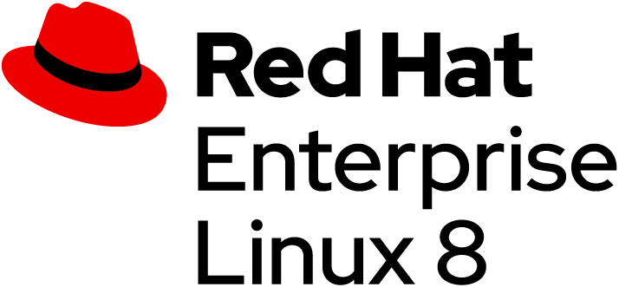



Container innovation continues ….
CONTAINERS ARE LINUX
buildah.io
podman.io
LXC Initial release
Docker initial
OCI
CNCF
Aug
‘08
Mid ‘14
Jun
‘15
Nov
‘15
Mar
‘16
Jun ‘17
May ‘18
Sep ‘18
May ‘19
May
‘11
Mar
‘13
Apr ‘17
Sep
‘17
OpenShift online
Moby
Buildah 1.0
Podman
New logo
Buildah Skopeo Podman RHEL
OpenShift Enterprise 3.0
Initial release, Buildah
Kubernetes

Slide 7
How did Docker change containers?
CONTAINERS ARE LINUX
Docker Daemon
Image Layers
Docker CLI
registry
Application
Docker daemon
App. Package Dependencies
CLI
App. Package Dependencies
image
container
Base Distro Image
kernel

Slide 8

Skopeo.
The first break away.
SKOPEO

Slide 9



SKOPEO
IMAGE COPY WITH SKOPEO
Built for interfacing with Docker registry
CLI for images and image registries
Rejected by upstream Docker ¯\_(ツ)_/¯
Allows remote inspection of image meta-data - no downloading
Can copy from one storage to another
Image Registry
SKOPEO
SECURITY FEATURES
Share securely
No daemon
Inspect remote images
No pulling potentially malicious images
Non-root copy. Bridge between registries.
Image Repository
/var/lib/containers
or
/var/lib/docker
Host
Notes:
Secuirty
No Daemon
Don’t pull malicious
Non-root copy. Bridge - no pull push
Works with :
Registries - e.g. Quay, Docker
containers/storage (OCI)
Filesystem - local directory
Docker storage (/var/lib/docker)
Docker-archive and oci-archive

Slide 10
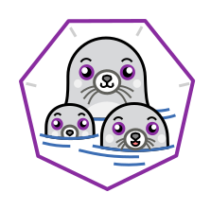
Podman.
The daemonless client for developers and beyond.
PODMAN

Slide 11

PODMAN
The new container CLI
@ podman.io
Client only tool, based on the Docker CLI. (same+)
No daemon!
Storage for
Images - containers/image
Containers - containers/storage
Runtime - runc
Shares state with CRI-O and with Buildah!
Image Registry
PODMAN
Containers
SECURITY FEATURES
Run and develop securely
No daemon
Run without root
Isolate with user namespaces
Audit who runs what
Images
Kernel
Notes:
No daemon
Building most priv
Running in prod less

Slide 12
PODMAN
Developer’s experience
Provides a familiar command line experience compatible with the Docker CLI
Great for running, building, and sharing containers outside of Kubernetes/OpenShift
Build and run containers as non-root (enhanced user namespaces)
Can be wired into existing infrastructure where the docker daemon/cli are used today
Use existing Dockerfiles
Simple command line interface, no client-server architecture
Docker compatible health checks

Slide 13
Podman
Demo
PODMAN DEMO

Slide 14
PODMAN
But there’s more : podman pod
Pods are a group of one or more containers sharing the same network, pid and ipc namespaces.
create Create a new empty pod
exists Check if a pod exists in
local storage
inspect Displays a pod configuration
kill Send the specified signal or
SIGKILL to containers in pod
pause Pause one or more pods
ps List pods
restart Restart one or more pods
rm Remove one or more pods
start Start one or more pods
stats Display a live stream of
resource usage statistics
for the containers in one or
more pods
stop Stop one or more pods
top Display the running
processes of containers in a
pod
unpause Unpause one or more pods

Slide 15

Buildah.
The secure container builder.
BUILDAH

Slide 16

BUILDAH
The separation of concerns
Developer
Workstation/Laptop
Container Platform
DataCenter
$ podman build
$ docker build
OCI Compliant
git
Source
Repo
Build
Test
Review/Appr
Deliver
Deploy
3rd Party
Image
Repo
CI/CD LIFECYCLE

Slide 17

BUILDAH
Why use Buildah?
Now buildah.io
Builds OCI compliant images
No daemon - no “docker socket”
Does not require a running container
Can use the host’s user’s secrets.
Single layer, from scratch images are made easy and it ensures limited manifest.
If needed you can still maintain Dockerfile based workflow
Application Layer
Java Runtime Layer
OS Update Layer
Java runtime and dependencies, and Application
Base RHEL
SECURITY FEATURES
Build securely
No daemon
Shrink the attack surface
Fine-grained control of the layers
Run builds isolated
Better secret management
From base,
multi-layer
From scratch,
single layer

Slide 18

What does Buildah do?
BUILDAH
buildah from - Build up a container root filesystem from an image or scratch.
buildah config - Adjust defaults in the image’s configuration blob.
buildah run - Run a command in the container’s filesystem using runc.
NOT like docker run. Like Dockerfile RUN.
buildah mount - Mount the container’s root filesystem on the host.
buildah commit - Commit container’s changes to a new image.

Slide 19
What does Buildah do?
BUILDAH
buildah push - Push images to registries (Quay etc.) or a local dockerd instance
buildah build-using-dockerfile (a.k.a. buildah bud) - Build images using a Dockerfile for instructions
buildah unmount - Oh, it also unmounts container filesystems
Provide a library API that’s used by the CLI
Share libraries and on-disk storage with CRI-O

Slide 20
CRI-O.
The OCI runtime abstraction for Kubernetes
CRI-O

Slide 21



CRI-O
OCI AND CRI-O
A Kubernetes thing
Now part of CNCF! (April 8th)
OCI daemon
Implements Kubelet Container Runtime Interface (CRI)
Container
Container
Kubernetes
READONLY
CRI-O
Container
SECURITY FEATURES
Run securely in a production cluster
No daemon
Read-only containers
Enable fewer capabilities
User namespaces
FIPS mode support
Container
Host
Notes:
CRI-O is the daemon with the least capabilities - less priv than Buildah or Podman container.
What happens:
OpenShift tells Kubernetes to execute a pod
Kubernetes communicates with crio
crio pulls image using skopeo, to containers/image
crio stores image on disk using containers/storage
crio runs pod’s container(s) using runC
There are a BUNCH, probably the majority of RH images that can't run in RO mode because they "write" data to strange place. It's an artifact of our RPM builds

Slide 22
Where do I find these projects in Red Hat products?
WHERE DO I GO FROM HERE?

Slide 23


WHERE CAN I FIND THESE AWESOME PROJECTS
IN RED HAT PRODUCTS?
WHERE? RED HAT PRODUCTS
SECURING THE PLATFORMS
SMART LIGHT CONTAINERS TOOL
CONTINUOUS BUILDING, SECURE RUNTIME
Red Hat chose to move away from Docker to Podman and Buildah can CRI-O in order to provide a more secure environment for containers on both OpenShift Container Platform and RHEL
The container-tools package installs Podman, Buildah and Skopeo together.
Users can use these in root or user namespace.
Red Hat OCP has been using Skopeo for efficiency for a number of years. OCP 4 moves to using Buildah by default for building container images. CRI-O is the default container runtime. Use Podman for helping to debug pods and containers.
QUICK TIP
Learn more about RHEL 8 and OpenShift Container Platform 4 at Red Hat Summit

Slide 24
Open source wins. Questions inspire community innovations.
OPEN SOURCE WINS

Slide 25

OPEN SOURCE WINS
Why do we have to pull down a container just to inspect it?
Could we decouple kubernetes from the container runtime?
Is it possible to build containers on a cluster without having to install and run a daemon?
How will we design, use, debug containers on the cluster if we don’t have client tools because we don’t have Docker?

Slide 26

OPEN SOURCE WINS
Getting Started
Download Podman today
Package name podman
It won’t clash with your existing Docker
If you feel more adventurous download Buildah too
Package name buildah
Or all with : container-tools
Lots of demos and tutorials are available
Contribute to the projects! (Next page)

Slide 27

Where can I learn more?
Where to find more information
Buildah
https://github.com/containers/buildah
https://buildah.io/
Podman
https://github.com/containers/libpod
https://podman.io/
Skopeo
https://github.com/containers/skopeo
Other useful links
https://github.com/opencontainers/runc
https://developers.redhat.com/blog/2019/02/21/podman-and-buildah-for-docker-users
https://www.katacoda.com/courses/containers-without-docker

Slide 28
Thank you
THANK YOU
Red Hat is the world’s leading provider of enterprise open source software solutions. Award-winning support, training, and consulting services make Red Hat a trusted adviser to the Fortune 500.

Slide 29
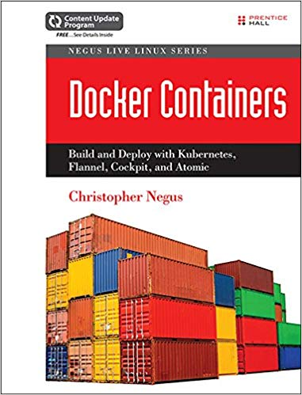
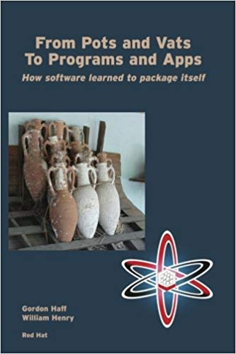
Who is this guy? Why listen to him?
INTRODUCTION
Started with Docker project when it became open source
March, April of 2014 - contributed all the manual pages for Docker
Contributing author to a couple of books on container technology
Saw the many issues/questions
Daemon, Security, Storage, Namespaces
Contribute to Buildah & Podman

